Slide 1
Digital Portfolio
STUDENT NAME: VAISHNAVI A
REGISTER NO AND NMID:614CDA4A84BCF3EACF74672B186E01AC
DEPARTMENT: BSC COMPUTER SCIENCE WITH DATA SCIENCE
COLLEGE: DHARMAMURTHI RAO BHADHUR CALAVALA CUNNAN CHETTY’s HINDU COLLEGE/ UNIVERSITY OF MADRAS

Slide 2
PROJECT TITLE DATA SCIENCE

Slide 3


AGENDA
Problem Statement
Project Overview
End Users
Tools and Technologies
Portfolio design and Layout
Features and Functionality
Results and Screenshots
Conclusion
Github Link
3/21/2024 Annual Review

Slide 4

PROBLEM STATEMENT Raw data alone has no value. The problem is to analyze and interpret data using Data Science techniques to find useful patterns, predictions, and insights.

Slide 5

PROJECT OVERVIEW This project showcases a portfolio of Data Science work, including predictive modeling, time-series forecasting, data visualization, and real-world dataset analysis.

Slide 6

WHO ARE THE END USERS? Students & Researchers – learning and experimenting with datasets Companies & Organizations – to make data-driven decisions Government & Agencies – for analysis and policy-making General Public – to understand insights through dashboards/reports

Slide 7

TOOLS AND TECHNIQUES Programming: Python Libraries: Pandas, NumPy, Scikit-learn, Matplotlib Visualization: Power BI, Plotly, Tableau Techniques: Data Cleaning, Data Visualization, Machine Learning, Time-Series Forecasting

Slide 8
POTFOLIO DESIGN AND LAYOUT
Clean and simple homepage with my name and tagline
Navigation bar (Home, About, Projects, Contact)
About section – photo + short bio
Projects section – project cards with details
Contact form & footer – presenter details + message option
8

Slide 9
FEATURES AND FUNCTIONALITY Responsive design (works on mobile & desktop) Interactive navigation bar with smooth scrolling Project cards showcasing Data Science works Hover effects for better user experience Contact form to connect with presenter

Slide 10
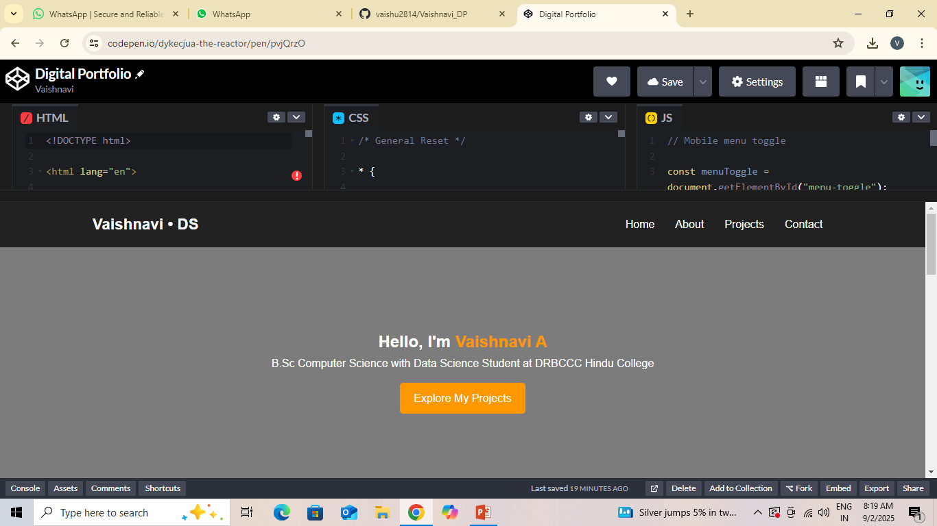

RESULTS AND SCREENSHOTS
3/21/2024 Annual Review
10

Slide 11
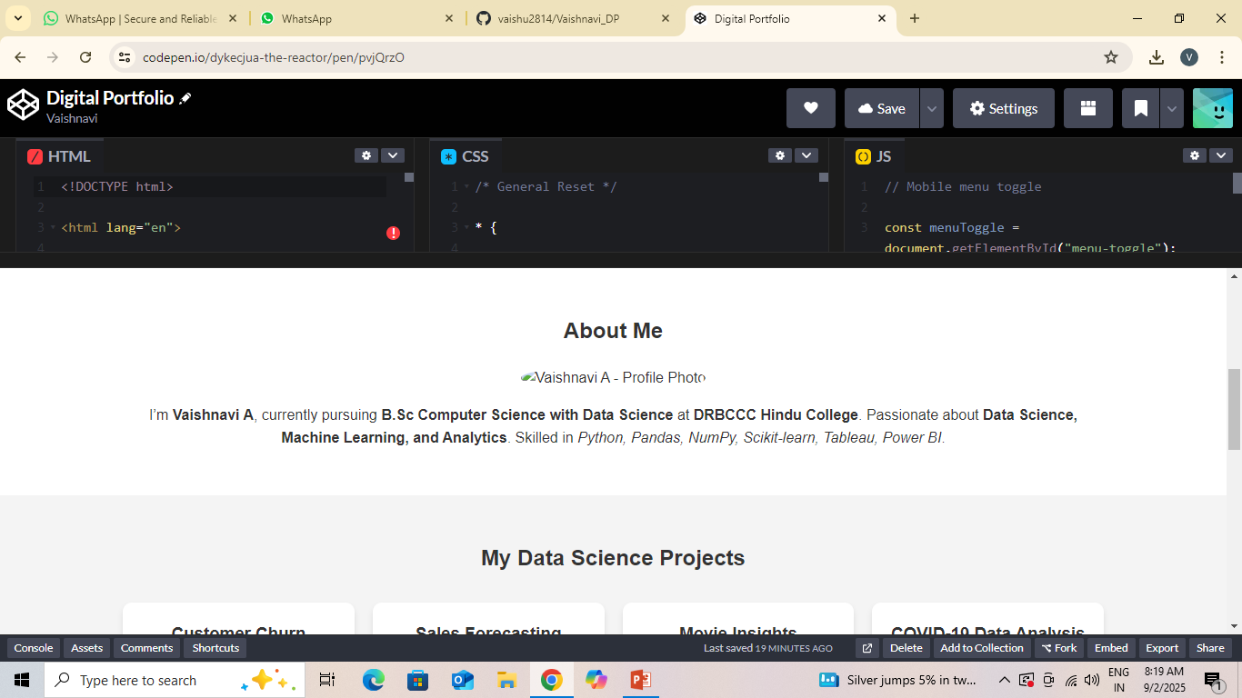
RESULT AND SCREENSHOT

Slide 12
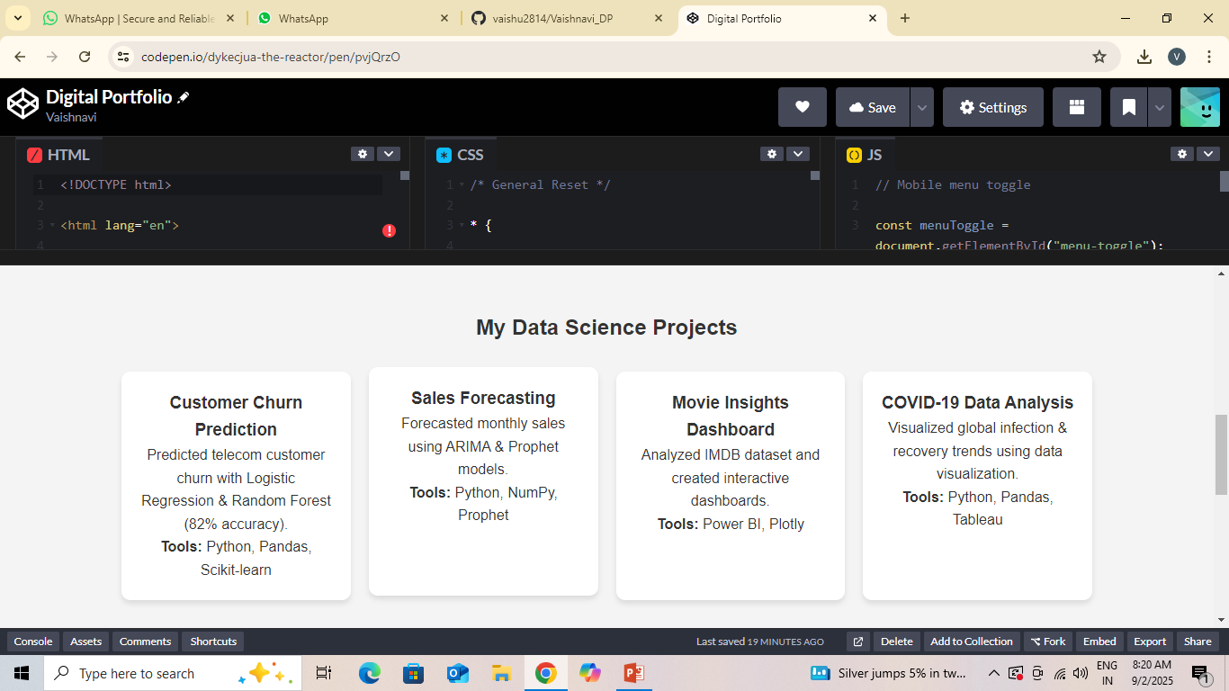

Slide 13
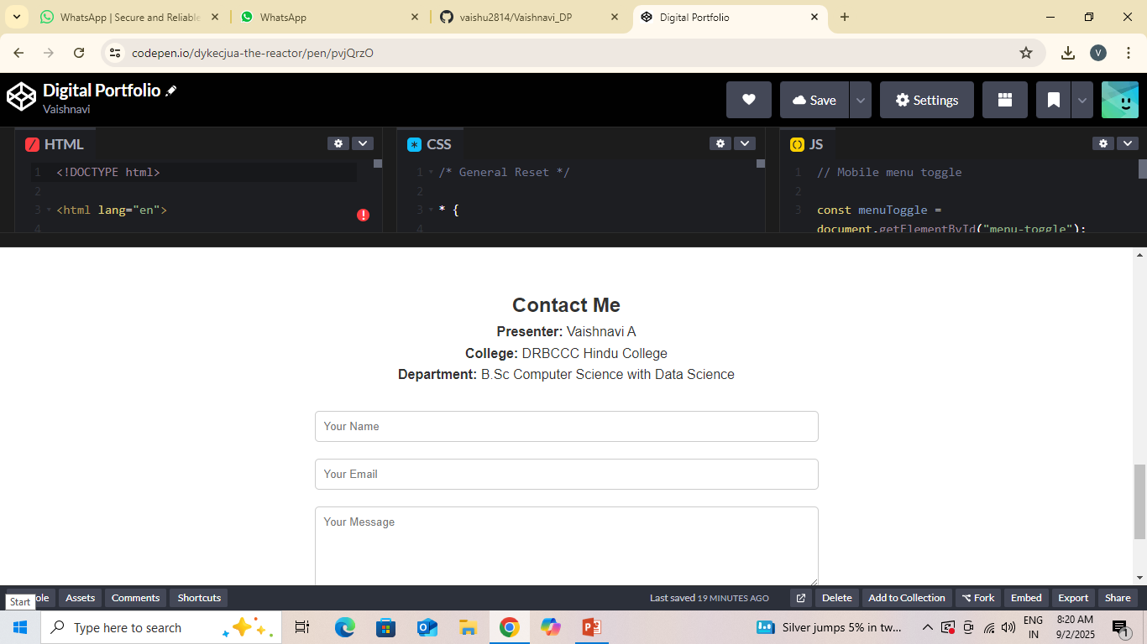

Slide 14
CONCLUSION The portfolio highlights my skills and Data Science projects in a structured way. It helps showcase predictive modeling, forecasting, and visualization work. Acts as a digital resume for academics, placements, and future opportunities.
14

